Slide 1



Parsoid Read Views is coming!
How do I keep up?
Mateus Santos / C. Scott Ananian
Content Transform Team, Wikimedia Foundation
August 8, 2025
Notes:
Hello. I am C. Scott Ananian, and I’m the Technical Lead for the Content Transform Team at the Wikimedia Foundation. I’m presenting today with Mateus Santos, Senior Product Manager at the Wikimedia Foundation. We’re talking to you today about Parsoid Read Views. Don’t worry, I’ll define what that means in a moment!

Slide 2
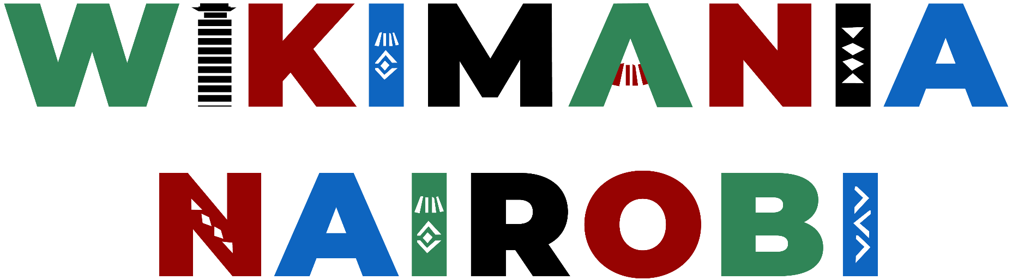

Outline
Parsoid and Wikitext
How you can help!
Testing, Confidence, and Feedback
Rollout Roadmap
After Read Views: Opportunities
Notes:
This talk will be in five parts. I’ll start by defining some terms and explaining what Parsoid is and how it relates to wikitext. Then we’ll talk about how you can use Parsoid on your home wikis and your daily work on wiki. Then I’ll hand it over to Mateus, who will show how we test Parsoid and collect feedback from readers and editors, then discuss the timing of the roll out of Parsoid across Wikimedia wikis. Finally we’ll talk briefly about the road ahead.

Slide 3

Parsoid and Wikitext
Notes:
I’ll start with Parsoid and wikitext, and begin by defining some terms.

Slide 4
Changing how articles are written (since 2012)
Wikitext is the markup language used to write articles on MediaWiki wikis.
The parser is the component which turns wikitext into HTML for browsers to display.
Parsoid is the next-generation wikitext parser; used in production since 2012 as the engine behind VisualEditor, our What-You-See-Is-What-You-Get editor.
Notes:
Wikitext is the markup language used to write articles on MediaWiki wikis. What the browser actually displays on the page is HTML. The parser is the component that converts wikitext to HTML, and Parsoid is the new parser we’ve been working on since 2012. The original reason for Parsoid’s creation was Visual Editor, a new way (at the time) to edit MediaWiki articles.

Slide 5
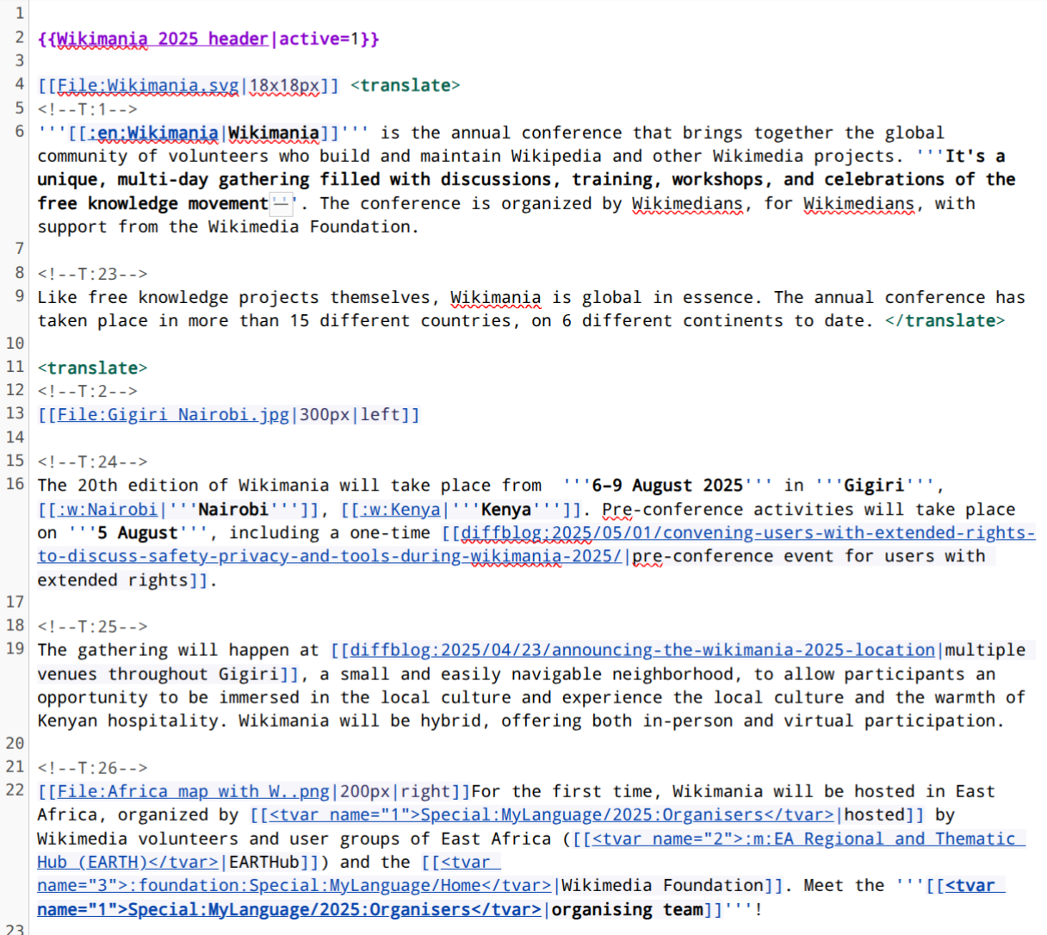
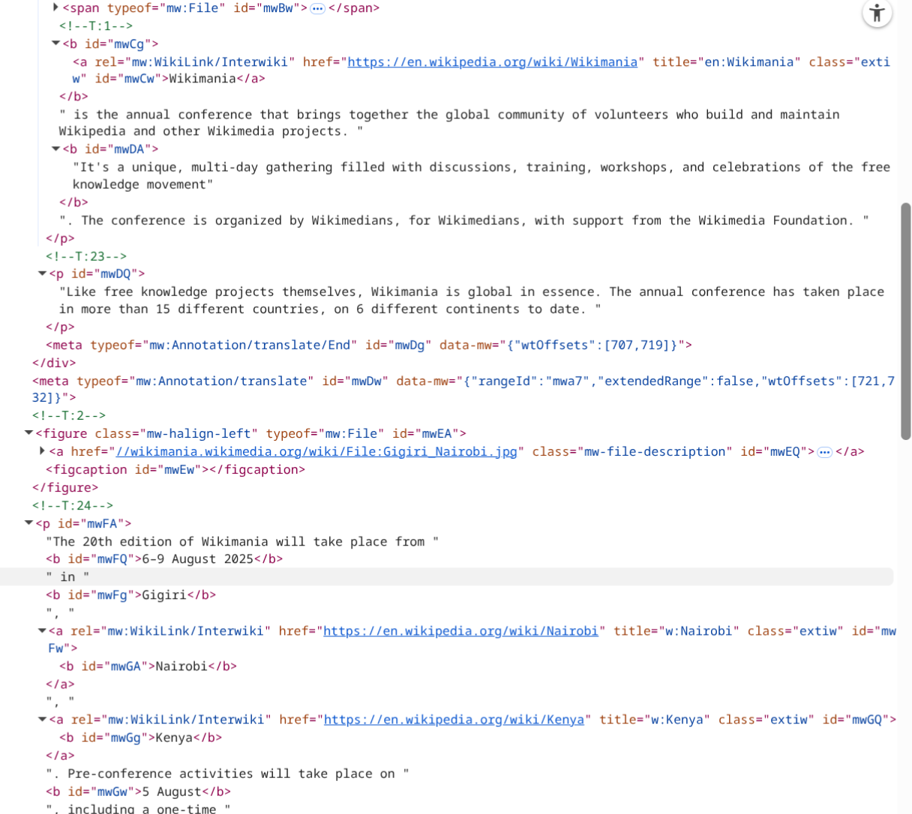
Wikitext -[Parsoid]-> HTML
Notes:
To show this visually, the text on the left is what an editor sees when they are using “edit source”, and working directly with the article wikitext.
On the right is the HTML generated by Parsoid for this wikitext.
Those of you who are wikitext experts might notice that even the “invisible” parts of the wikitext markup, like the start and end of this translation region, are represented in the HTML output.

Slide 6
Changing how articles are written (since 2012)
Wikitext is the markup language used to write articles on MediaWiki wikis.
The parser is the component which turns wikitext into HTML for browsers to display.
Parsoid is the next-generation wikitext parser; used in production since 2012 as the engine behind VisualEditor, our WYSIWYG editor.
  Contains a number of new features compared to the previous parser, including support for round-trip conversion from HTML back to wikitext, and preservation of semantic information.
  In the process of building Parsoid we have been standardizing, documenting, and cleaning up the behavior of wikitext.
Notes:
This is the main feature of Parsoid, compared to the old parser: it preserves all the information from the original wikitext, including template boundaries, comments, and other invisible metadata and markup. This enables round-trip conversion from wikitext to HTML and then back to wikitext, allowing us to edit wikitext with a what-you-see-is-what-you-get HTML editor.
But in the process we’ve also (by necessity) had to grapple with the wild and woolly nature of wikitext: documenting and standardizing it, and often cleaning up its rough edges.

Slide 7

Parsoid Answers!
“Where does this come from? What is it?”
“How do I write this in wikitext?”
“Wouldn’t it be nice if…”
“Why can’t I edit this?”
Notes:
These are the sorts of questions Parsoid allows us to answer:
“Where is this coming from?” It allows us to match up the HTML in your browser and the original wikitext, so if you were to point at an item on your browser page we can tell you exactly where in the wikitext that thing came from. “What is it?” By preserving information about template boundaries and arguments and other invisible features of the wikitext, Parsoid can also provide additional meaning (“semantics”) for the things you see. For example, “this bit of HTML is an infobox”.
“How do I write this in wikitext?” Parsoid’s motto is “we deal with wikitext so you don’t have to!” Parsoid generates a stable intermediate representation which is easier for tools (and humans, in the case of Visual Editor) to write, and then takes care of all the gnarly details of how to not just /properly/ write this as wikitext, but also /elegantly/ write this as wikitext. It turns out that our editors have a keen grasp of /style/ in the wikitext they like to author on the projects, and Parsoid is careful to generate wikitext that fits in, that matches the way that human editors format their wikitext. (This varies on different projects!)
Wouldn’t it be nice if wikitext would let me write this more easily? Or if I could mark this in some way? Our ultimate goal with Parsoid is to enable new wikitext features, and we are eager to hear from you all what those ought to be.
Finally: “Why can’t I edit this?” This isn’t related to your permissions on wiki, per se, but there are certain templates which are uneditable on wiki for technical reasons: usually because they are frequently used and thus every edit to them causes the reparse of hundreds or thousands of other pages, and our servers can’t take too much of that. The incremental rendering features we are exploring in Parsoid will help reduce the backend impact of edits to these frequently used templates, and that, in turn, may allow fewer of these to be protected and thus allow you to edit more.

Slide 8

Parsoid used since 2012 for
Visual Editor
Content Translation Tool
Discussion Tools
Flow
Mobile Apps
Kiwix Offline Browser
(and more!)
Jamal Nxedlana, from Bubblegum Club, on behalf of Moleskine Foundation, CC BY-SA 4.0
Notes:
Although we began Parsoid for use by editors, and its use has grown over time and Parsoid now powers Content Translation, Flow, Wikimedia Enterprise, Discussion Tools, Kiwix, and our mobile apps…

Slide 9
Changing how articles are read (since 2024)
Maintaining multiple wikitext parsers is not sustainable!
The Parser Unification project aims to gradually replace the legacy wikitext parser entirely with Parsoid
In 2024 we began to roll out Parsoid for read views on Wikimedia wikis
Notes:
Yet the HTML which desktop users see has been generated by the old, legacy, parser. Maintaining multiple parsers is not sustainable, and we began the Parser Unification project to gradually replace all uses of the legacy parser with Parsoid. In 2024 we began to roll out Parsoid for read views—to generate the HTML you see when you visit an ordinary article page to read it.

Slide 10
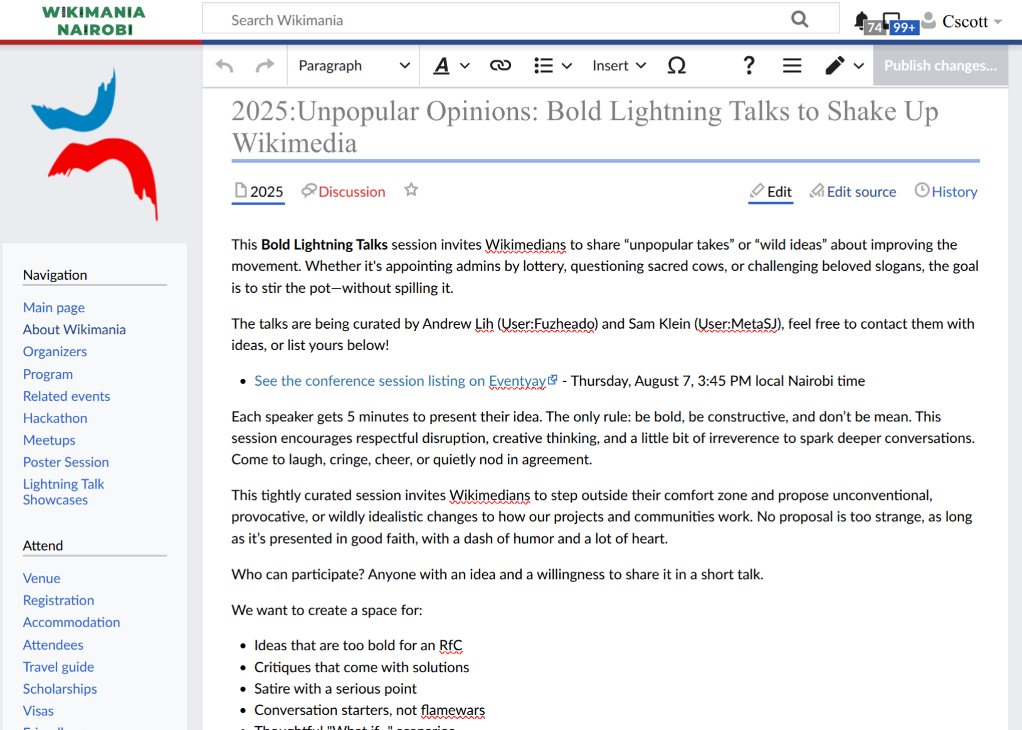
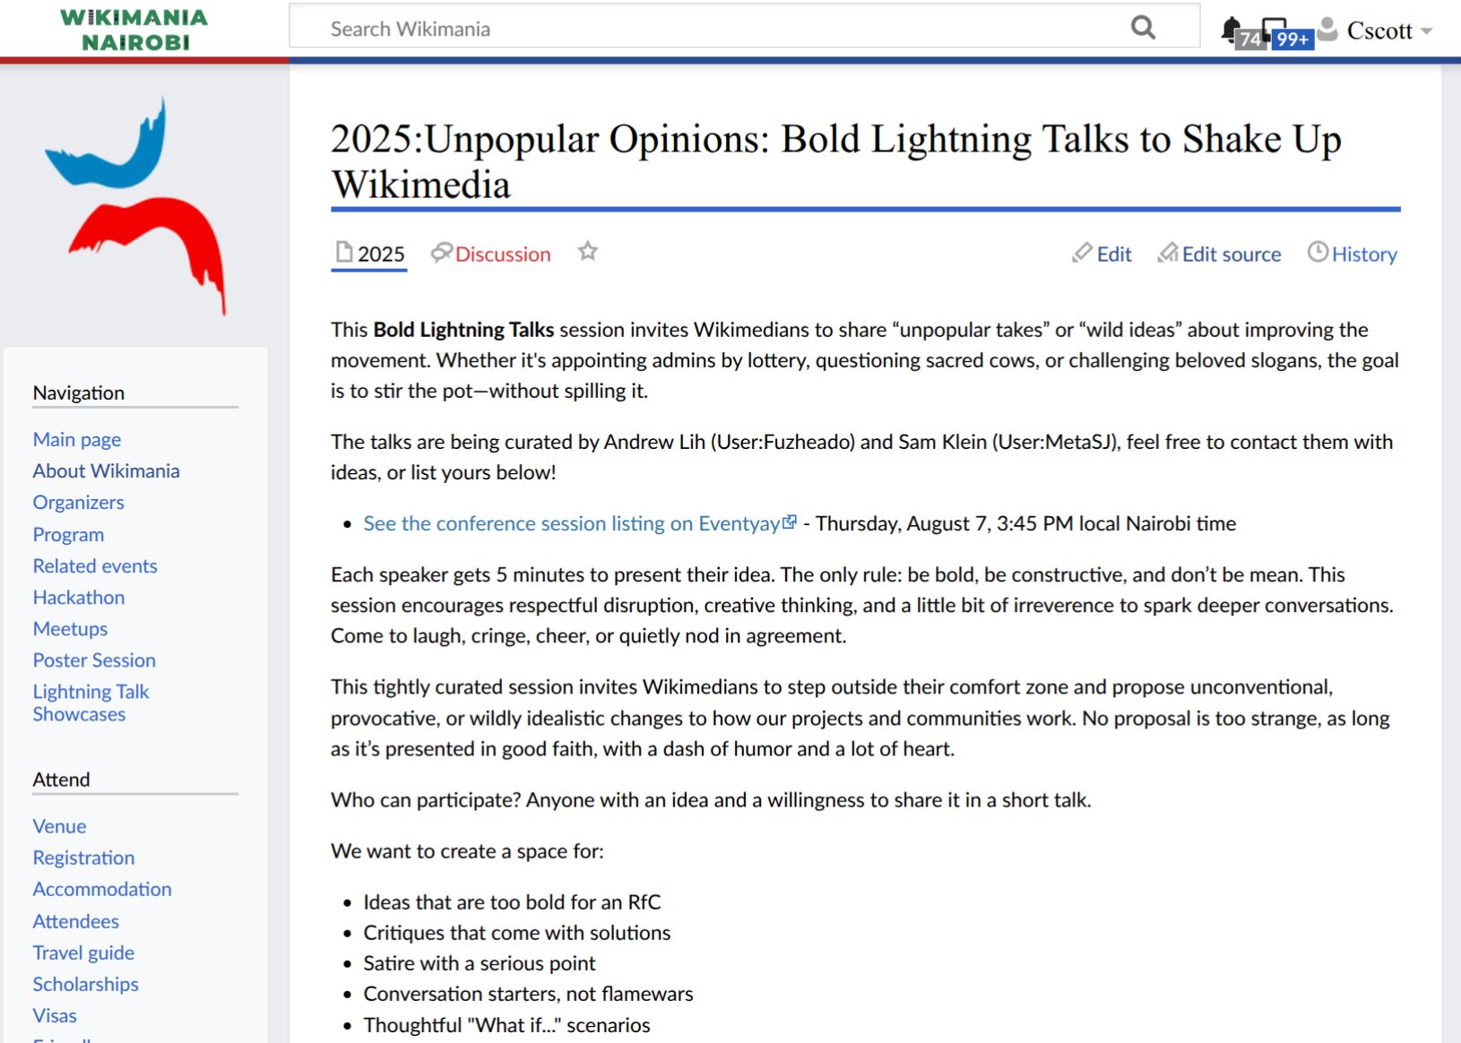
Edit Read
Notes:
Visually: on the left is VisualEditor, our WYSIWG article editor. When you click into Visual Editor, the content you see has been generated from Parsoid from the start.
On the right is what a reader sees. That has been generated by the legacy parser and is now transitioning to Parsoid.
These are very similar, and that’s the point! Parsoid is quite a mature codebase and there should be few if any differences between how Parsoid displays an article for a reader and how the legacy parser does.

Slide 11
2. You can join us on the transition to Parsoid Read Views!
[[Extension:ParserMigration]] is installed on WMF wikis and can be installed on any MW 1.42+ wiki and allows site-wide as well as per-user opt-in to use the new Parsoid wikitext parser.
Notes:
This is our first exciting announcement, which we’d like to spread widely: you can help us test Parsoid read views. The ParserMigration extension is installed on all WMF wikis (and third-party wikis can install it as well) and it allows per-user opt-in to use Parsoid for article views instead of the legacy parser. In most cases we expect this to be super boring, because the Parsoid output will look identical to the legacy parser output – I mean, 99% of pages are likely pixel-by-pixel identical. However, the point of doing the test and opt-ing in early is to try to find the places where this isn’t the case, and get a head start on resolving compatibility issues. We’ll show you in a moment how to report issues. But this is how you can opt-in early…

Slide 12
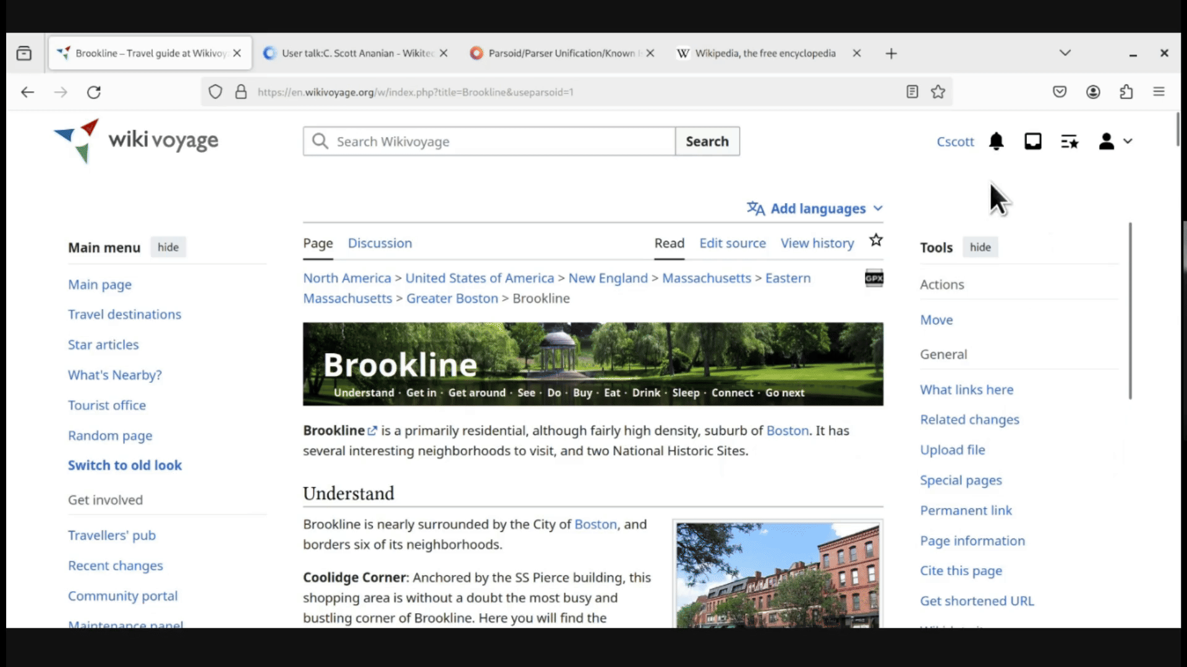
Notes:
Go to your user preferences, scroll down to your global preferences, click, go to the editing tab, scroll all the way down again, and click "Use the new Parsoid wikitext parser" and "Always" in the drop down.

Slide 13
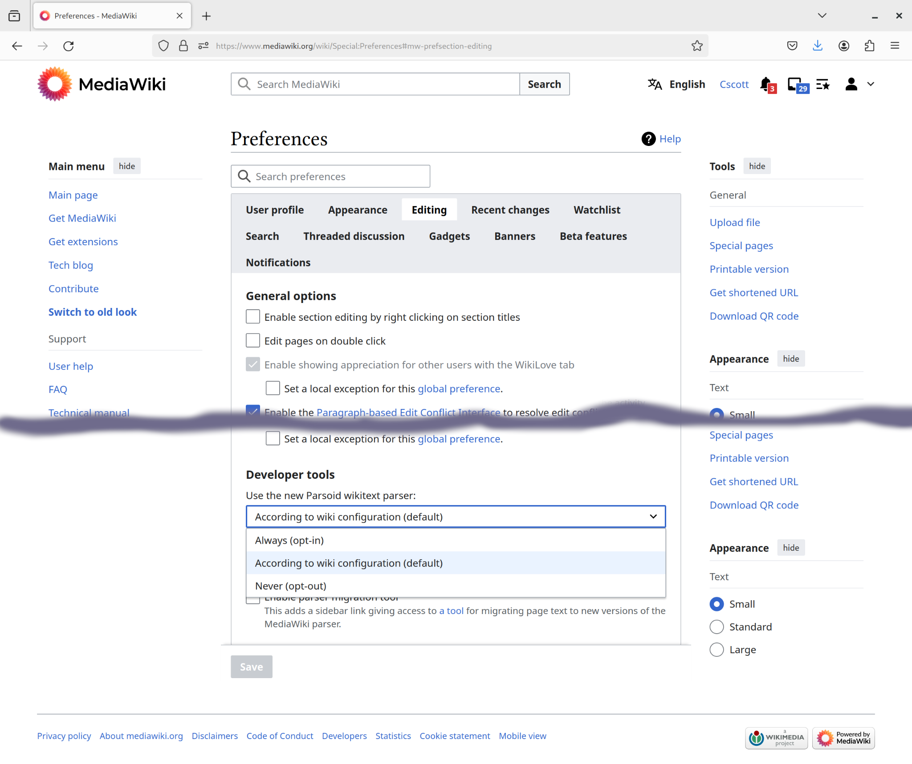

Parsoid opt-in using
[[Extension:ParserMigration]]
Notes:
If you didn’t catch that, here’s a static version: In your “Editing” preferences, scroll allll the way down to Developer Tools you can opt-in (or opt-out) to using Parsoid for read views. There is also a per-wiki default, which affects what folks who don’t touch this preference see. Over the next months the per-wiki default will be gradually switched from the legacy parser to Parsoid on a wiki-by-wiki basis. Please take the time to opt-in in your preferences and help us find issues before everyone else! If you find that Parsoid affects your daily work as an editor or admin, you can opt-out. There are also links to switch to and from Parsoid in the sidebar on individual pages.

Slide 14

3. Testing, Confidence, and Feedback
Notes:
Now I’m going to hand over to Mateus to talk about how we test Parsoid for readers, how we know when we can turn on Parsoid Read Views for a given wiki, and how you can provide feedback.

Slide 15
The Confidence Framework
Overview
Purpose: Evaluate readiness and effectiveness for Parsoid deployment on various wikis.
Methodology: Steps and methods for comprehensive evaluations and informed Parsoid deployment decisions.
Framework's Goal
Use data to encourage deeper product inquiries.
Support fast iterations by allowing confident
experimentation and stable deployments
Transparent communication with communities by
providing the reasoning behind Parsoid Read Views roll-out
More information: https://www.mediawiki.org/wiki/Parsoid/Parser_Unification/Confidence_Framework
Notes:
Our decision to switch the wiki default is based on a Confidence Framework our team has developed. We have a pixel-by-pixel comparison tool to compare the output of the legacy parser and the new Parsoid parser and we use quantitative data to guide our decisions. This approach not only boosts confidence in Parsoid deployment for Read Views but also aligns with our commitment to a transparent and data-informed process, ensuring the highest standards of deployment readiness and effectiveness.

Slide 16
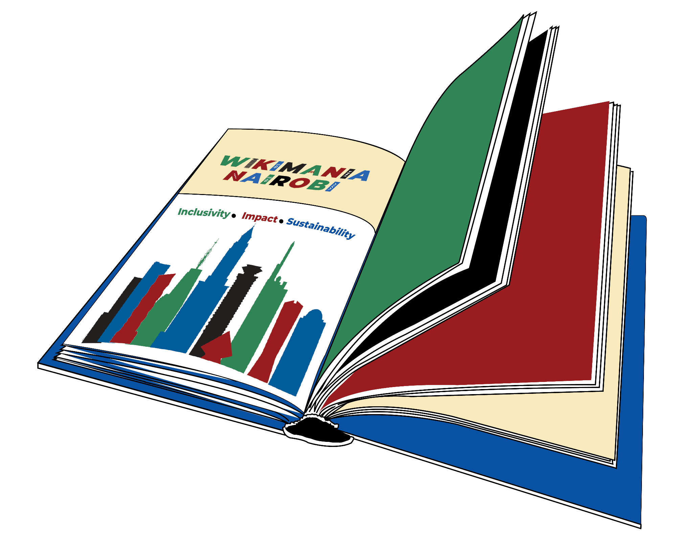
Visual Diff and Round-trip testing
Each week we do round-trip testing on tens of thousands of pages, which ensures that Parsoid can round trip a page edit from wikitext to HTML and then back to wikitext without dirty diffs.
We also use visual diff testing to compare renderings from Parsoid and the legacy parser to look for pixel-level differences in rendering.
Notes:
We do round-trip testing every week on tens of thousands of pages before we release that week’s version of Parsoid to production. Before we enable Parsoid Read Views on a new wiki, we also do what we call “visual diff testing” which compares how the page looks with both Parsoid and the legacy parser.

Slide 17
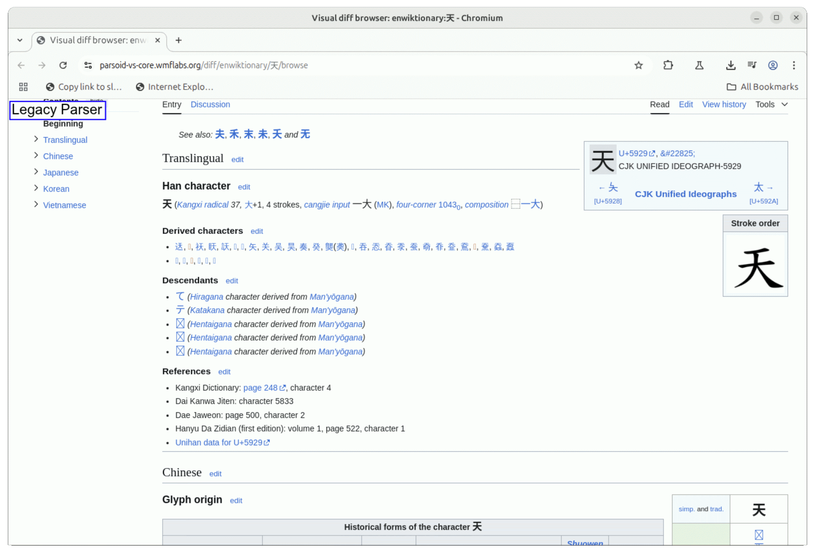
Visual Diff Testing
Notes:
This takes screen shots of the page as rendered with the legacy parser, and with parsoid, and highlights and scores differences.
These could be small things, like a link missing, or a color shift, or somewhat larger differences like this section of text which was shifted to the right.

Slide 18

Report a Visual Bug
If you are using Parsoid read views, in the toolbar menu is a new item, “Report a Visual Bug”
This allows us to collect feedback from readers and editors on any rendering differences caused by Parsoid.
Notes:
A new feature we added recently is a toolbar item which allows you to “Report a Visual Bug” if you are using Parsoid Read Views and you identify some rendering difference caused by Parsoid.

Slide 19
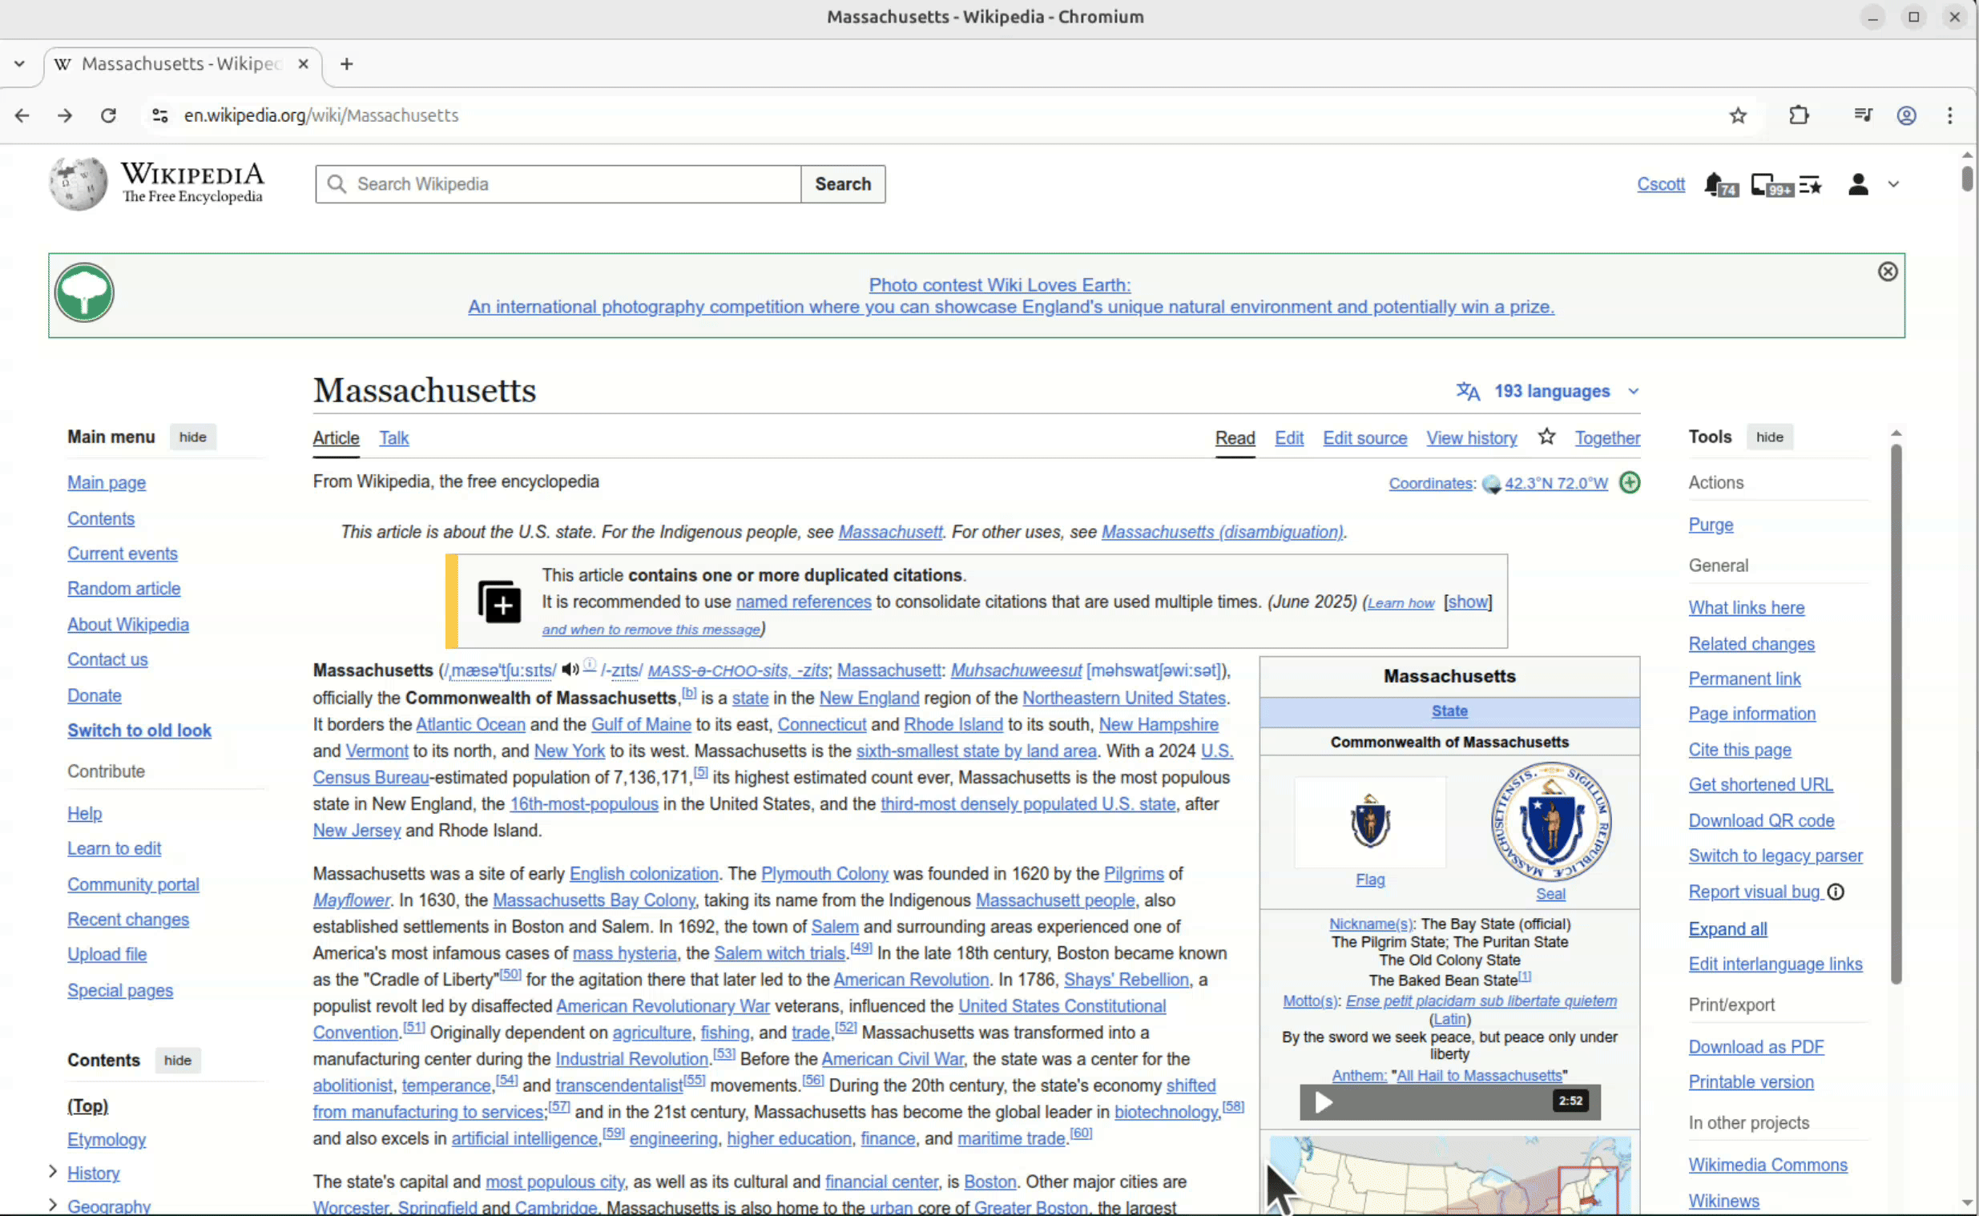
Report a Visual Bug
Notes:
Here’s a quick demo. The “Report Visual Bug” item is in the toolbox in the right sidebar. A dialog is displayed, you can type a description of the problem, and when you click submit it is added to a wiki page along with the page and revision that you were looking at. Our team reviews and responds to reports here.

Slide 20

How you can help!
Opt in to Parsoid Read views
  Preferences→Editing→
  Developer Tools→
  Use Parsoid: Always
Look for differences
  Use sidebar to switch back to check issues
  Pay special attention to dynamic behaviors & gadgets
Report bugs
  [[mw:Parsoid/Parser_Unification/Known_Issues]]
CC0, Francis Akuka for the Wikimedia Foundation
Notes:
As I mentioned, most pages are pixel-by-pixel identical. But we have a [known issues page]], and we don’t catch everything. In particular, user gadgets and dynamic behaviors sometimes aren’t captured by our visual diff tool. What we need is for you, as our friendly beta-testers, to try out Parsoid as a daily driver and help us find the things we *don’t* already know about, as well as help prioritize fixing any bugs we do know about. If this change is going to affect your workflow or the articles you watch, we want to know as soon as possible.

Slide 21

4. Roll-out Roadmap
Notes:
Let’s talk about the timeline for switching all our wikis to Parsoid Read Views.

Slide 22
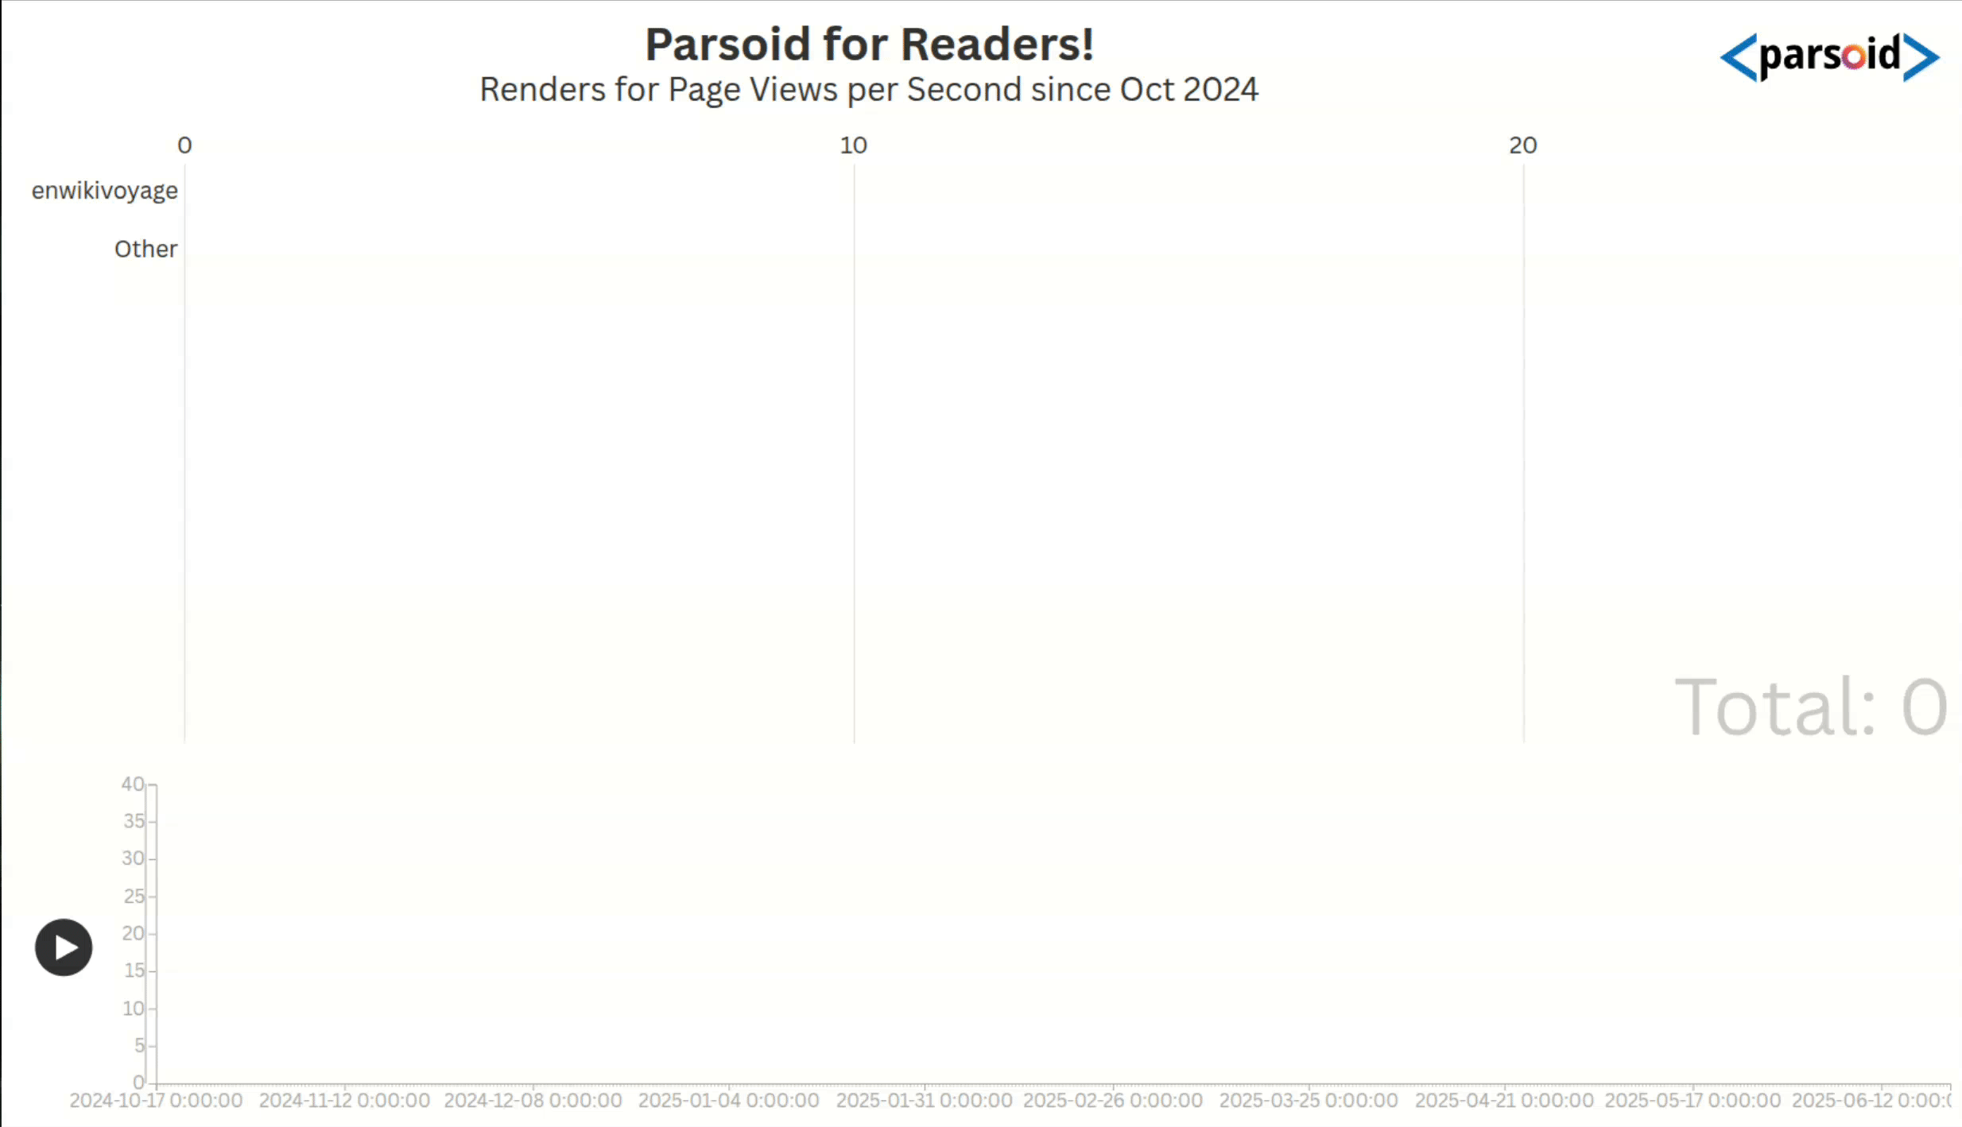
Notes:
Here you can see our rollout so far. We started with wikivoyage, then enabled Parsoid for incubator and for all newly-created wikis going forward, then turned on Parsoid Read Views for Wikitionaries at the beginning of this year.

Slide 23



CC0, Francis Akuka for the Wikimedia Foundation
CC by SA 4.0, Alexmbogo
CC by 2.0, Nina R Africa
Wikivoyage
Incubator and new wikis
Wiktionary
Deployment of Parsoid read views on Wikivoyage started in Fall 2024.
Parsoid was made the default render for Incubator and any newly-created wikis in Winter 2024.
Parsoid read views deployed on most Wiktionaries between February and April 2025.
Parsoid on 39 low-page-view Wikipedias on July 28, 2025!
Notes:
And on July 28 we just deployed Parsoid on 39 new Wikipedias!

Slide 24

Parsoid on
Wikipedia
We expect to complete rollout to all Wikipedias by June 2026.
  Additional work beyond that point on sister projects and backend tools.
Parsoid will ship as the default wikitext parser in MediaWiki 1.47 LTS in November 2026.
Legacy parser will remain an option until next LTS (roughly November 2028).
CC0, Francis Akuka for the Wikimedia Foundation
Notes:
We expect to complete rollout to all Wikipedias by June of next year, and we hope to ship Parsoid as the default wikitext parser in MediaWiki 1.47 next November. Note that we might not have Parsoid Read Views enabled on absolutely every WMF wiki in production at that point, but by shipping with Parsoid as the default renderer we are communicating to third-parties that this is how new wikis should be configured. You will still be able to switch the default parser back to legacy, at least for the duration of the long-term support cycle for 1.47.

Slide 25
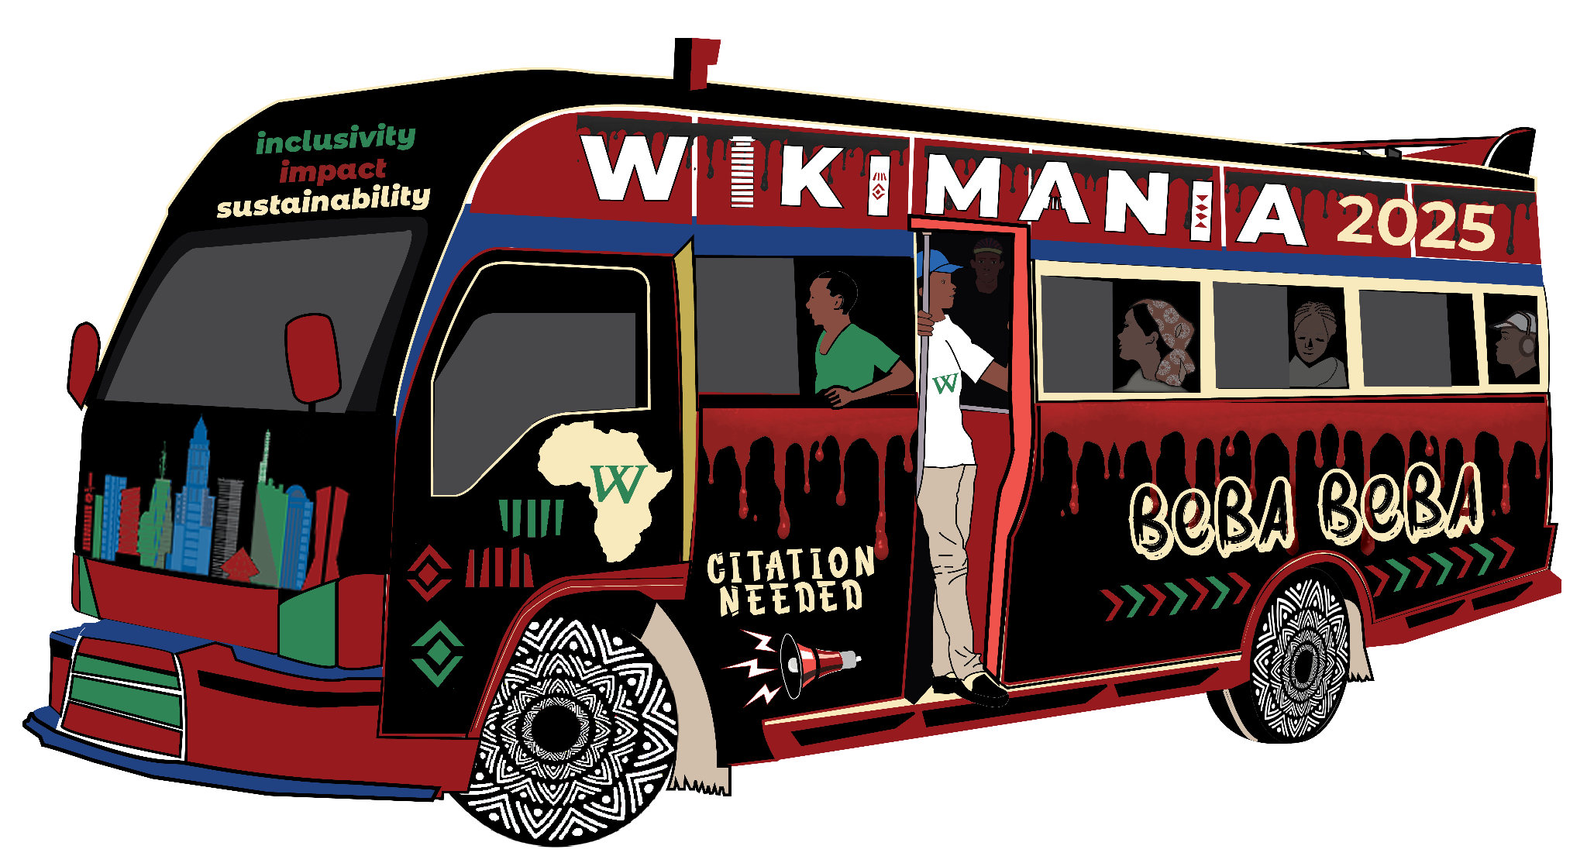
5. After Read Views: Opportunities
Notes:
We’ll close by briefly description our product vision for wikitext.

Slide 26



Future of Wikitext
Wikitext is the one way the community communicates and records knowledge. The future requires a product vision for wikitext:
Syntax improvements to make authoring and editing easier
New ways of capturing meaning across languages
Better ways to reuse content to support movement inclusivity, impact, and sustainability
Notes:
The big ideas are:
Syntax improvements to address editor pain points. We want to hear from you about what can help you.
Ways to capture meaning from wikitext that work across projects, and increasing content reuse. Some possible mechanisms might include encoding meaningful information about template arguments using TemplateData, or by leveraging that information to better translate templates across projects or to localize the presentation of shared data generation functions.
The future is exciting, and we look forward to it!

Slide 27

Q&A

